Slide 1
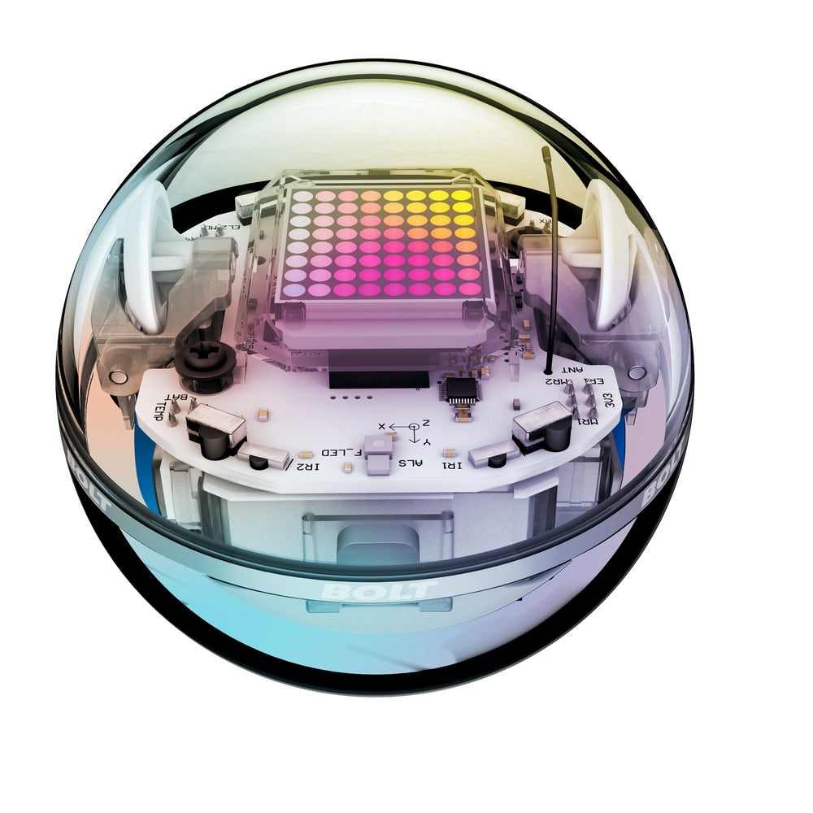
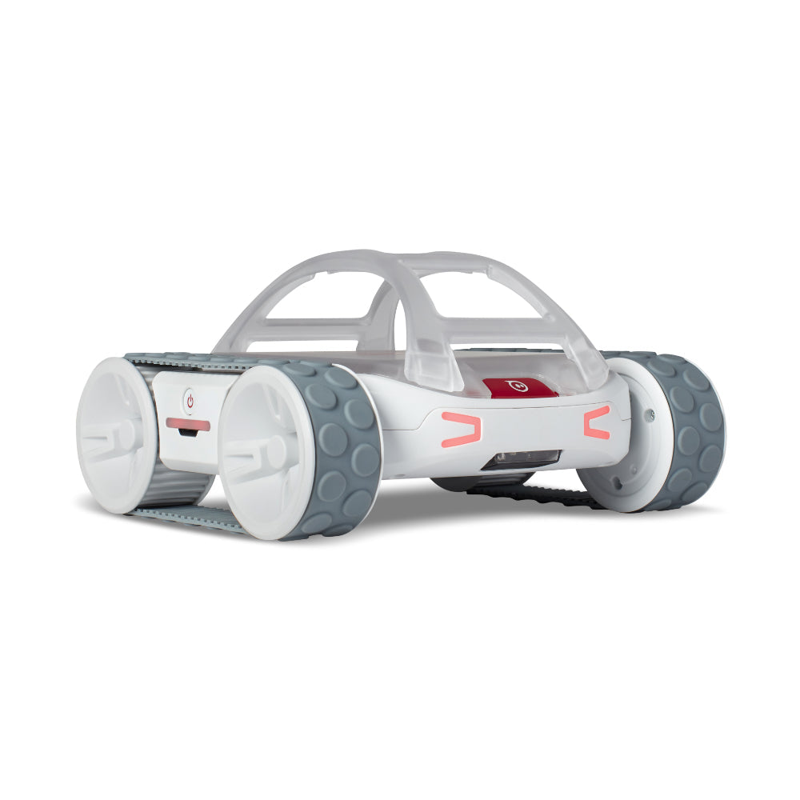
Heterogeneous Swarming of RVR & BOLT Robots

Slide 2
Update
Part 1 – Creating basic heterogenous swarms of both BOLT and RVR
Part 2 – Creating swarming formations with the two

Slide 3
Current Work
Bluetooth communication between RVR and BOLT
RVR will act as a “host” for multiple BOLT robots and will maintain control of its own BOLTs
Python implementation of RVR and BOLT as boids
Modifying ViCON bridge and RVR Swarm Controller codes to allow for ViCON for both, and for RVR to understand when it is receiving it’s own location and when it’s receiving it’s BOLT locations

Slide 4
Future:
Before the interim report:
Basic boid model swarm with both robots running
With ViCON
No distinct formations
After interim repot:
Boid model swarm with formations
Asymmetric swarming

